Slide 1


The details of the project & the requirements are listed in the power point slides from 1 to 10
Custom project VBA
The slide 11 to 23 are the screenshot of the each action as per the project requirement after developing the VBA coding.
Project related VBA code is available in the Excel macro enabled excel file by name custom project_vba1

Slide 2
Agenda
Project - VBA
  Summary Sheet
  Dashboard Sheet

Slide 3
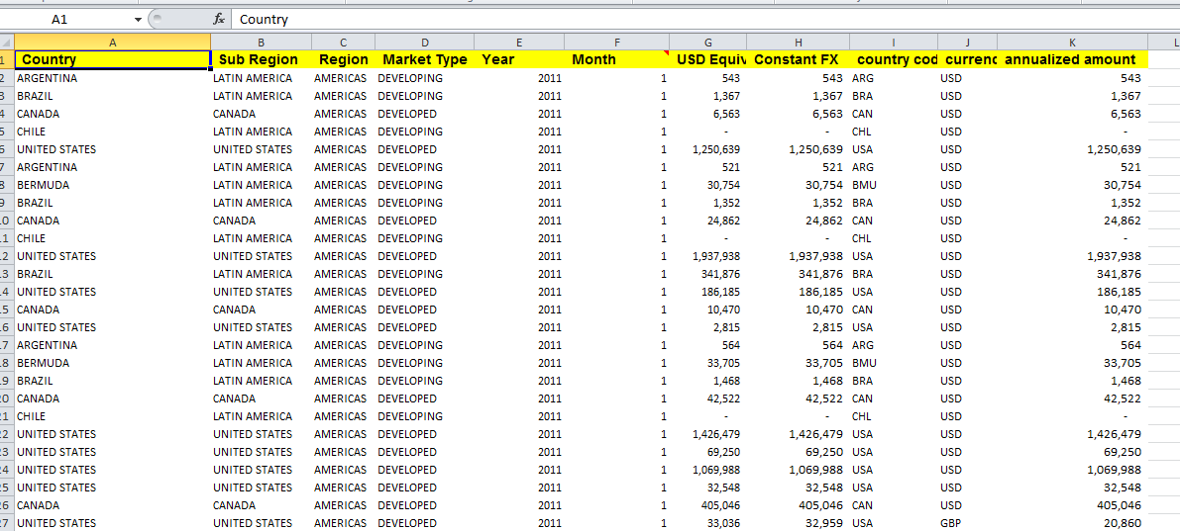
Project
Now, we need to create a project report using our VBA Skills. The dataset we need to use is given below:-

Slide 4
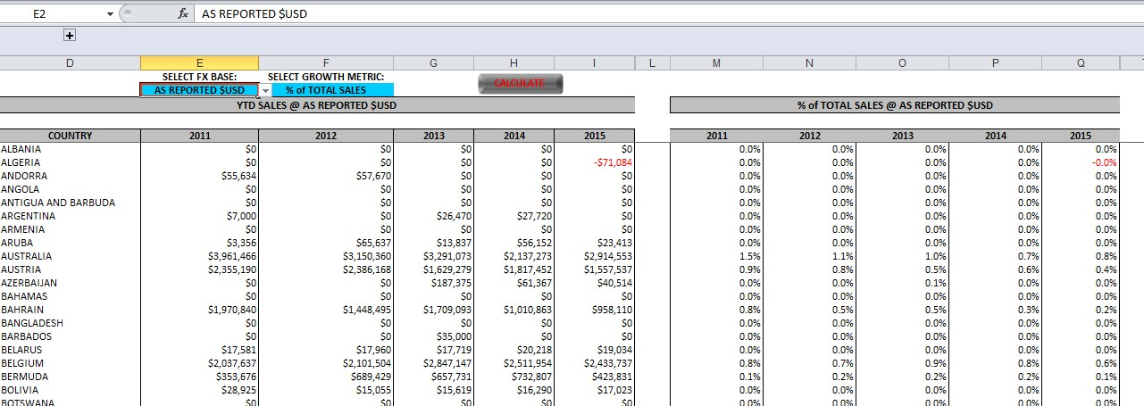
Project - Summary Sheet
Using this Dataset, we need to create a Summary sheet as given below.
1. It contains two sections - Sum of Sales(left section) by country and Growth Metrics(right section)

Slide 5
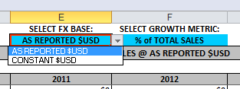
Project - Summary Sheet
The Sum of sales and Growth metrics calculation depends on two drop downs
  SELECT FX BASE:
  SELECT GROWTH METRIC:
3. When we select “AS REPORTED $USD” both of these sections should be calculated on [USD Equiv] column. If we select “CONSTANT $USD”, both sections should be calculated on [Constant FX] column.

Slide 6
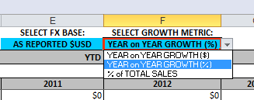
Project - Summary Sheet
In the second drop down, we have three values in the same order.
  YEAR on YEAR GROWTH ($)
  YEAR on YEAR GROWTH (%)
  % of TOTAL SALES
YEAR on YEAR GROWTH ($) : -Difference between current year’s sale from last year’s sale.
YEAR on YEAR GROWTH (%):- % growth from last year
% of TOTAL SALES :- % of Sale in this country to total Sale

Slide 7
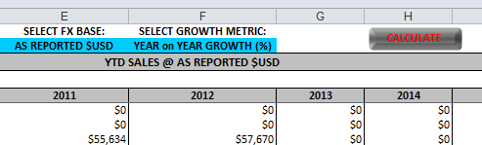
Project - Summary Sheet
4. All of the above calculations should be done on one Button Click called
Calculate. All the formulas in this sheet should be calculated and pasted as value .
So when I click on ”Calculate” button both section should contain numbers( no
Formula) based on these two drop downs.

Slide 8
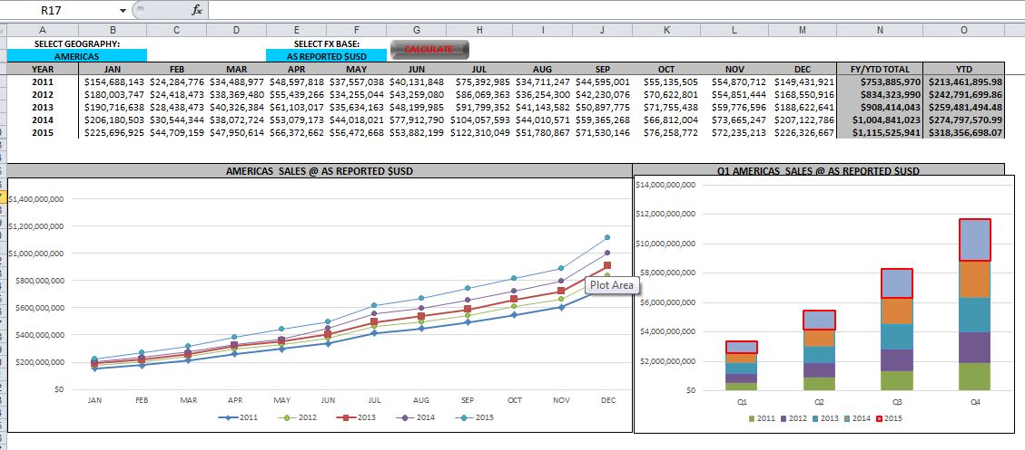
Project - Dashboard Sheet
1. Another sheet(called Dashboard), will contain a summary of sale on year at the top and two chart - Trend Chart and Stacked bar chart.
The Trend chart shows trend for each month in these years and stacked chart shows
quarterly Sale for each year as given below.

Slide 9
Project - Dashboard Sheet
This tab also contain two drop downs and summary in the table is created based on the drop down selection.
  SELECT GEOGRAPHY
  SELECT FX BASE:
For example , if we select “AMERICAS” in and in drop down two “CONSTANT $USD” then click on “Calculate” both the charts and summary table should be updated based on
selection(in drop down).

Slide 10
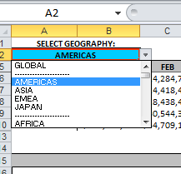
Project - Dashboard Sheet
The drop down for Geography should contain the below given things(All of these are available in dataset):-
  Global - for showing sum of all the regions, need to calculate
  Four regions ( Americas, Asia, EMEA and Japan)
  Sub Region like Africa, Latin America etc.
  Market Type like Developed, Developing
  Country – Name of all the countries
The used of this Dashboard should be able to aggregate (sum) the sales on any of the above things.
  We need to use VBA for all the calculation as we want this file to be as light as possible. The user should not be able see any formulas but only the aggregated values.

Slide 11
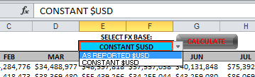
Project - Dashboard Sheet
The FX Base drop down should have the same three values as in previous sheet.
  YEAR on YEAR GROWTH ($)
  YEAR on YEAR GROWTH (%)
  % of TOTAL SALES
YEAR on YEAR GROWTH ($) : -Difference between current year’s sale from last year’s
sale.
YEAR on YEAR GROWTH (%):- % growth from last year
% of TOTAL SALES :- % of Sale in this country to total Sale

Slide 12
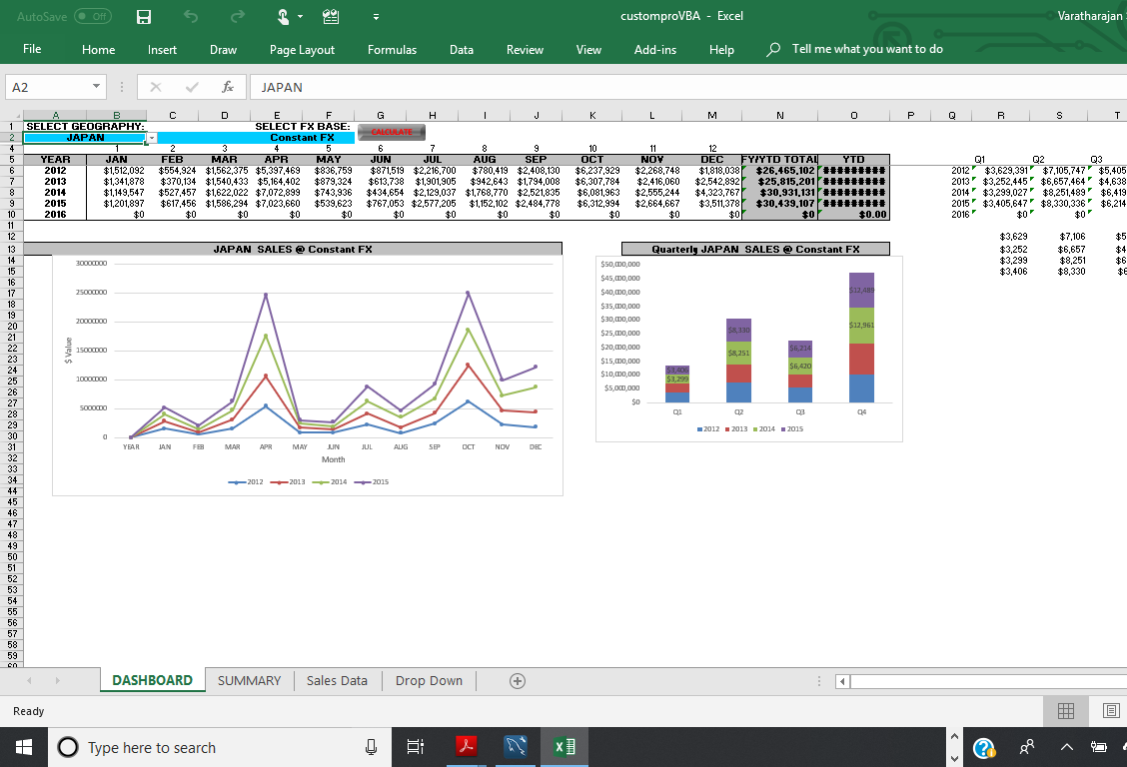
Custom pro VBA project Developed using our VBA Skills. The dataset is given below:- We have selected japan and constant Fx and shown the updated changes in the dash board from the summary sheet after clicking the calculate button. We can select USD Equv. as well

Slide 13
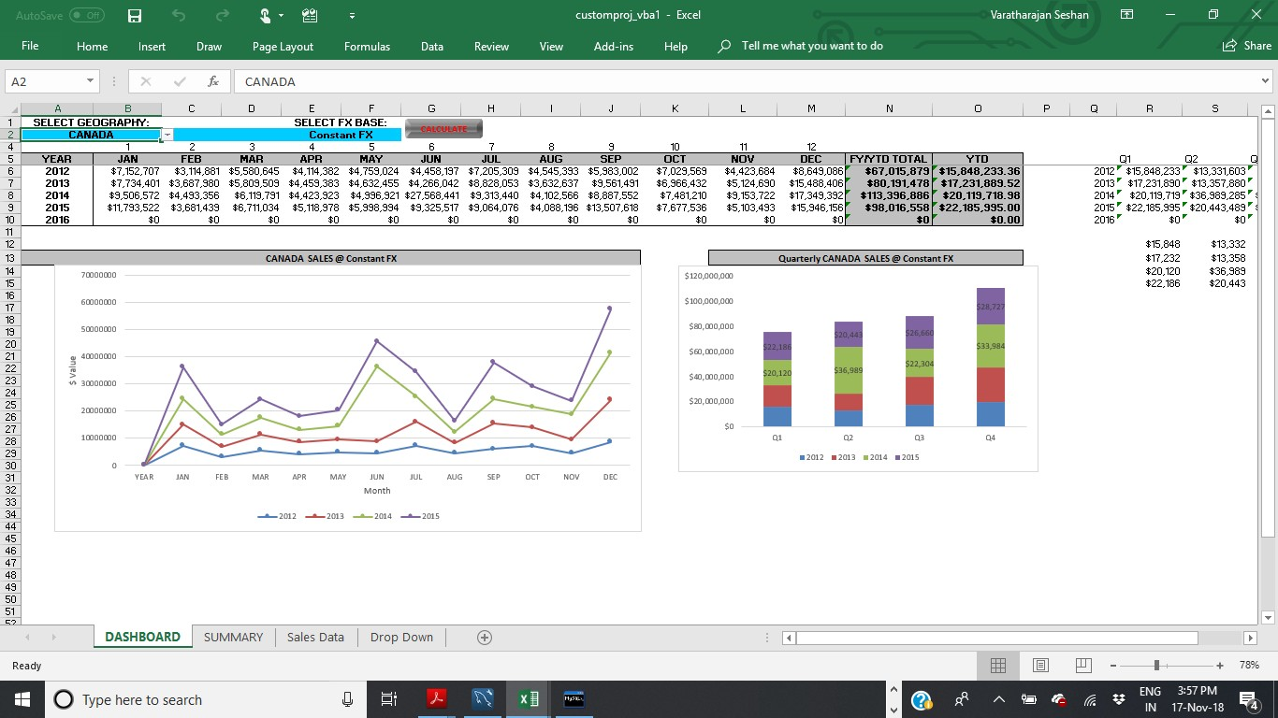
Custom pro VBA project Developed using our VBA Skills. The dataset is given below:- We have selected japan and constant Fx and shown the updated changes in the dash board from the summary sheet. We can select USD Equv. as well

Slide 14

Custom pro VBA project Developed using our VBA Skills. The dataset is given below:- We have selected japan and USD Equv. and shown the updated changes in the dash board from the summary sheet.

Slide 15
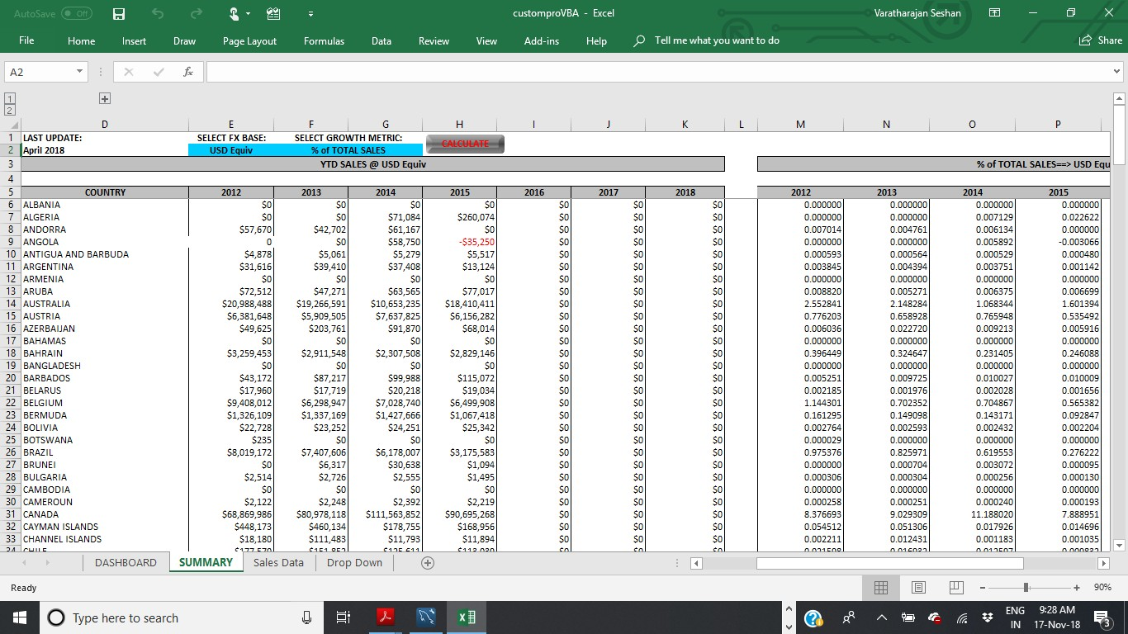
Summary sheet is given below:- We have selected %Total sales and USD Equv. shown the updated changes in the summary sheet from the summary sheet. We can select constant Fx. as well

Slide 16
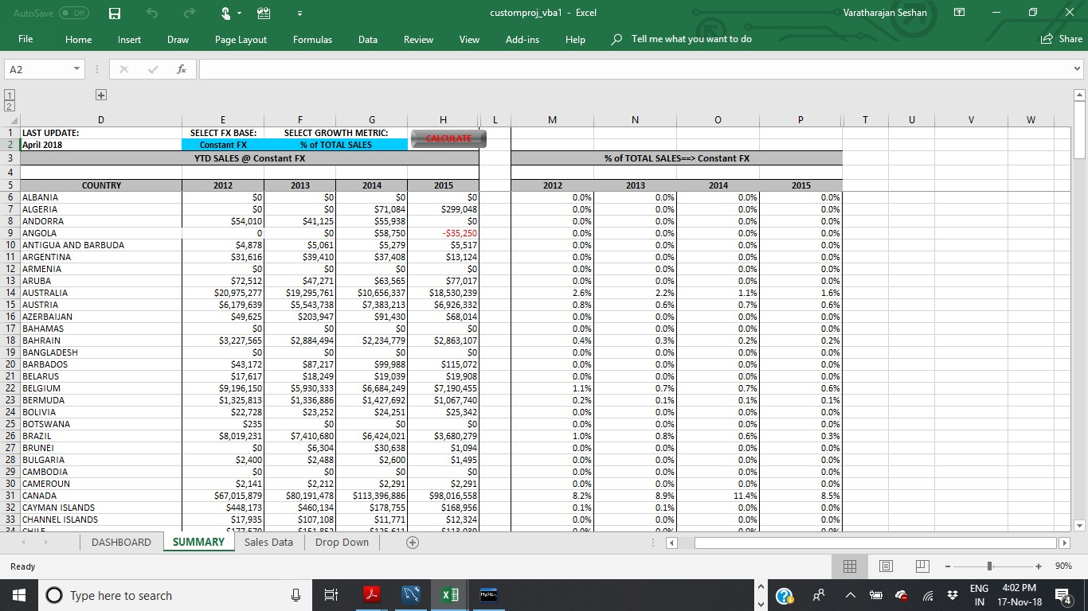
Summary sheet is given below:- We have selected %Total sales and constant Fx. shown the updated
changes in the summary sheet from the summary sheet. We can select USD Equv. as well

Slide 17
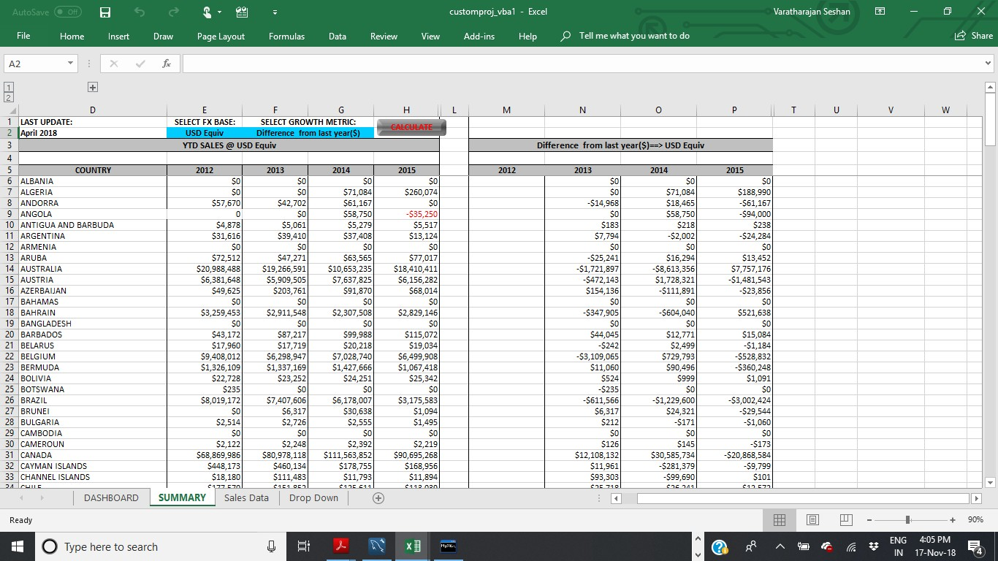
Summary sheet is given below:- We have selected Difference from last year($) and USD Equv. shown the updated changes in the summary sheet from the summary sheet. We can select constant Fx. as well

Slide 18

Summary sheet is given below:- We have selected Difference from last year($) and Constant FX shown
the updated changes in the summary sheet from the summary sheet. We can select USD Equv. as well

Slide 19

Summary sheet is given below:- We have selected Difference from last year($) and constant Fx. Shown the updated changes in the summary sheet from the summary sheet. We can select USD Equv. as well

Slide 20
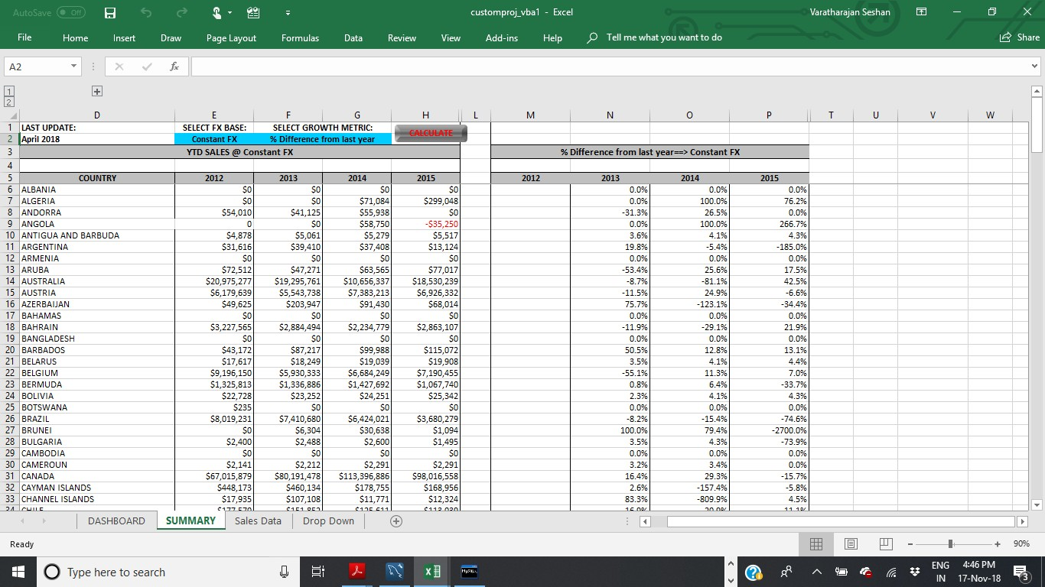
Summary sheet is given below:- We have selected Difference from last year(%) and Constant FX shown the updated changes in the summary sheet from the summary sheet. We can select USD Equv. as well

Slide 21

Summary sheet is given below:- We have selected Difference from last year(%) and. USD Equv. Shown the updated changes in the summary sheet from the summary sheet. We can select constant Fx as well

Slide 22
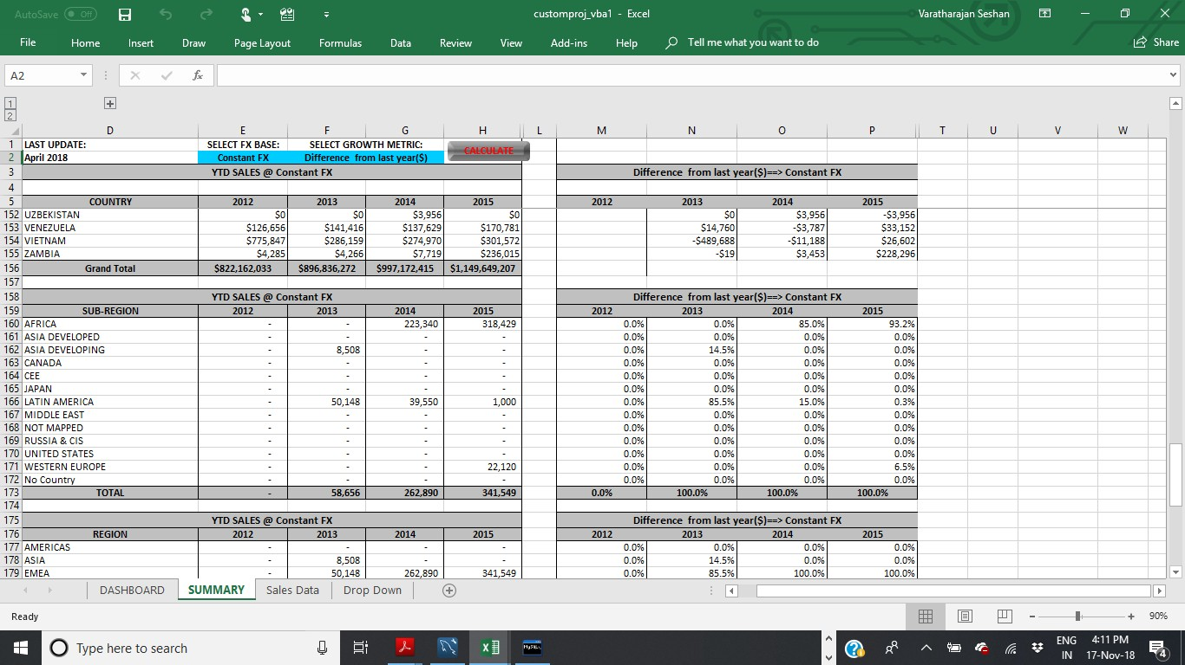
Summary sheet is given below:- The given below tables are also updated when we select Menus from the
dropdown list and based on the selection of constant Fx or USD equivalent,

Slide 23









Acknowledgements
This is a quite interesting VBA project and I have gained a lot of knowledge about EXCEL VBA macro coding for a global sales data , dashboard and Forex conversions. I thank the institute Acadgild and the Mentors Dr.Vinod and Mr. Mohit & Ms. Puja who taught us the R and VBA coding and other subjects. I once again thank Acadgild for enlighten me on Excel analytics, Machine learning through online teaching and various coding support through the support coordinators. Thank you Acadgild.

Slide 24


